Slide 1
Linked List

Slide 2
Linked List
Linked List can be defined as collection of objects called nodes that are randomly stored in the memory.
A node contains two fields i.e. data stored at that particular address and the pointer which contains the address of the next node in the memory.
The last node of the list contains pointer to the null.

Slide 3
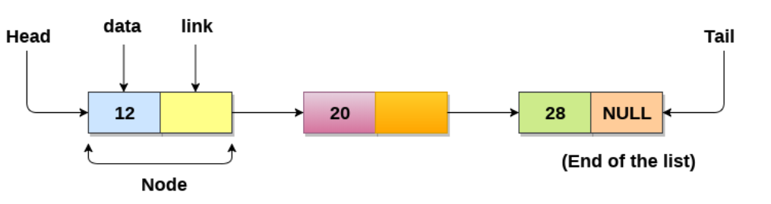

Slide 4
Uses of Linked List
The list is not required to be contiguously present in the memory. The node can reside any where in the memory and linked together to make a list. This achieves optimized utilization of space.
list size is limited to the memory size and doesn't need to be declared in advance.
Empty node can not be present in the linked list.
We can store values of primitive types or objects in the singly linked list.

Slide 5
Why use linked list over array?
Till now, we were using array data structure to organize the group of elements that are to be stored individually in the memory. However, Array has several advantages and disadvantages which must be known in order to decide the data structure which will be used throughout the program.
Array contains following limitations:
The size of array must be known in advance before using it in the program.
Increasing size of the array is a time taking process. It is almost impossible to expand the size of the array at run time.
All the elements in the array need to be contiguously stored in the memory. Inserting any element in the array needs shifting of all its predecessors.

Slide 6
Linked list is the data structure which can overcome all the limitations of an array. Using linked list is useful because,
It allocates the memory dynamically. All the nodes of linked list are non-contiguously stored in the memory and linked together with the help of pointers.
Sizing is no longer a problem since we do not need to define its size at the time of declaration. List grows as per the program's demand and limited to the available memory space.

Slide 7
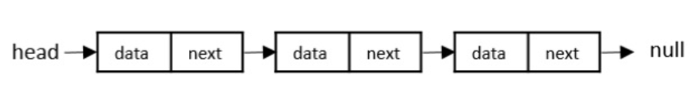
Types of Linked List
Singly Linked Lists
Singly linked lists contain two "buckets" in one node; one bucket holds the data and the other bucket holds the address of the next node of the list. Traversals can be done in one direction only as there is only a single link between two nodes of the same list.

Slide 8
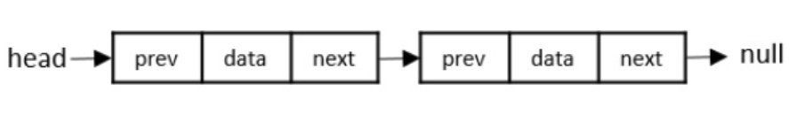
Doubly Linked Lists
Doubly Linked Lists contain three "buckets" in one node; one bucket holds the data and the other buckets hold the addresses of the previous and next nodes in the list. The list is traversed twice as the nodes in the list are connected to each other from both sides.

Slide 9
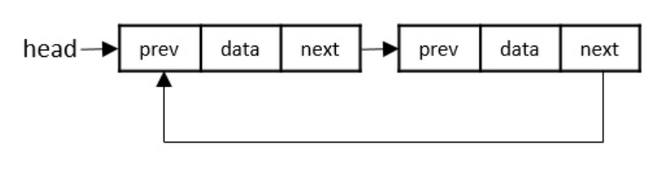
Circular Linked Lists
Circular linked lists can exist in both singly linked list and doubly linked list.
Since the last node and the first node of the circular linked list are connected, the traversal in this linked list will go on forever until it is broken.

Slide 10
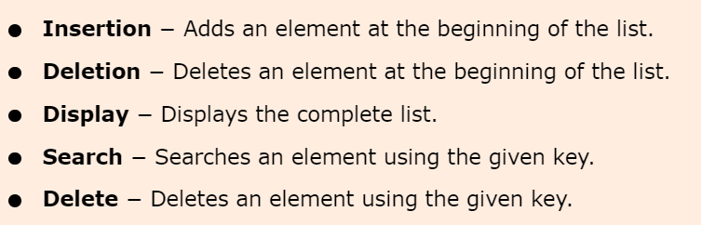
Basic Operations in Linked List
The basic operations in the linked lists are insertion, deletion, searching, display, and deleting an element at a given key. These operations are performed on Singly Linked Lists as given below −

Slide 11
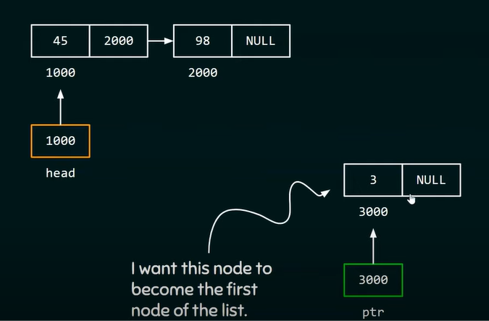

Slide 12
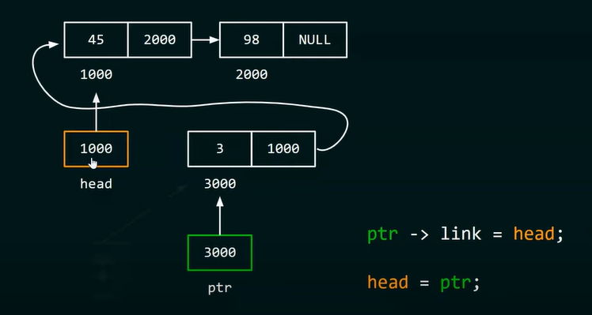

Slide 13
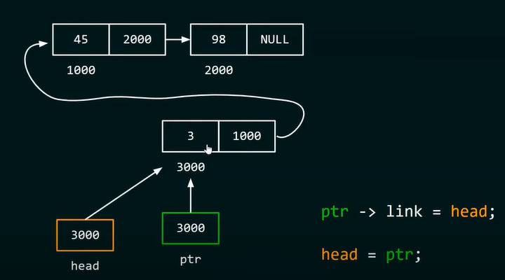

Slide 14
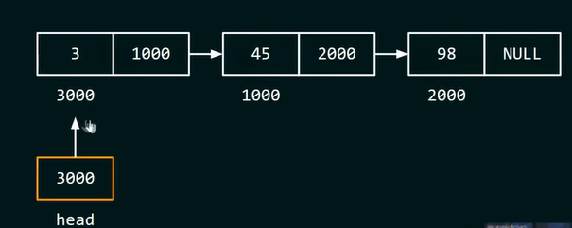

Slide 15
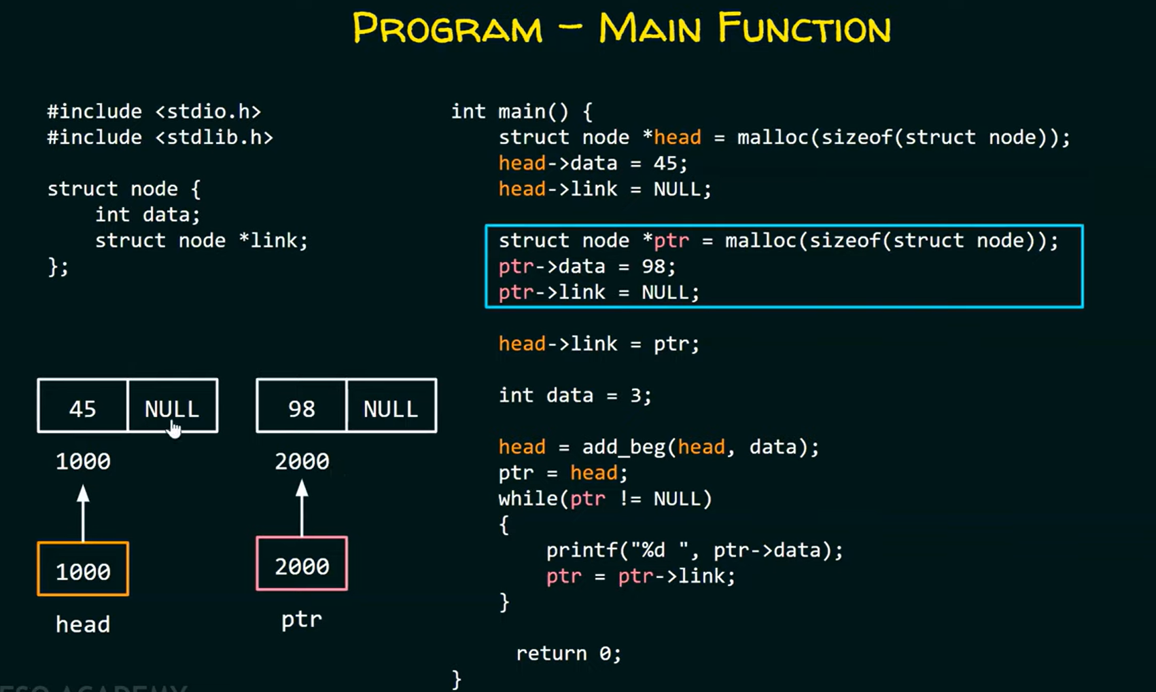

Slide 16
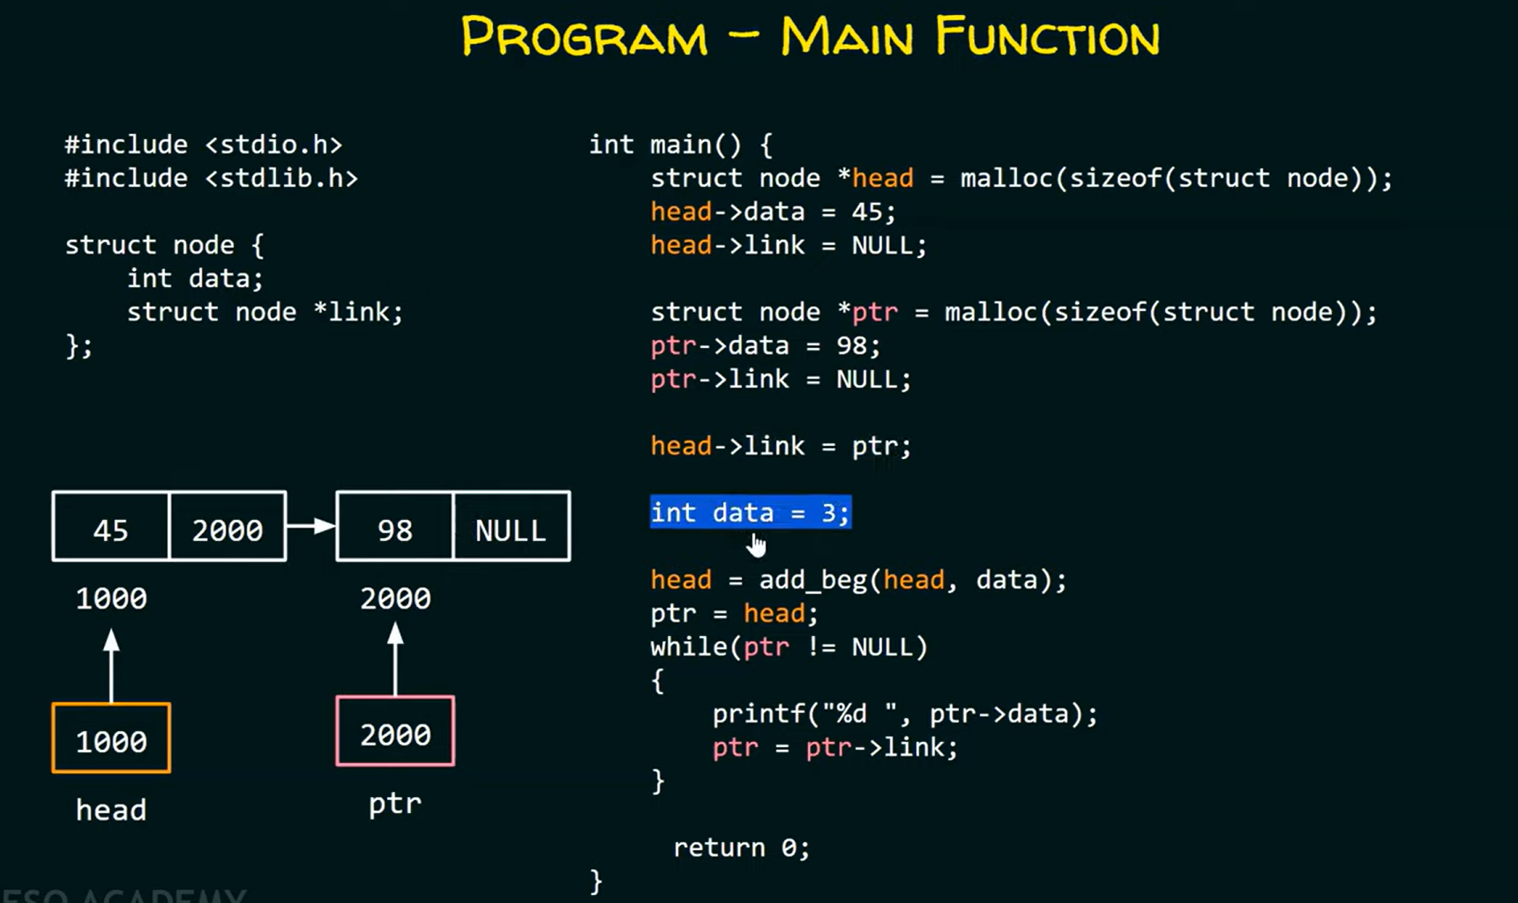

Slide 17
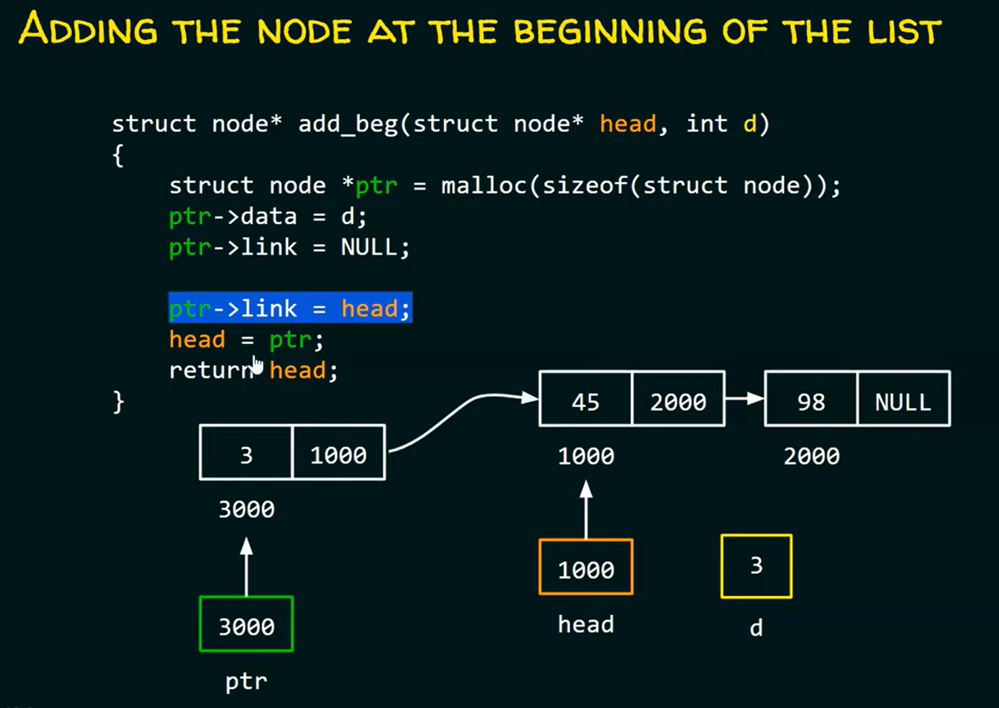

Slide 18
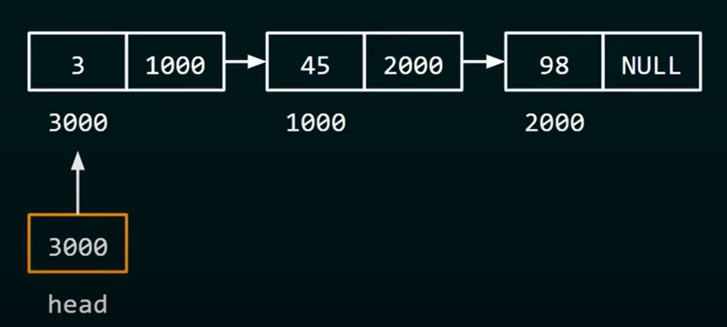

Slide 19
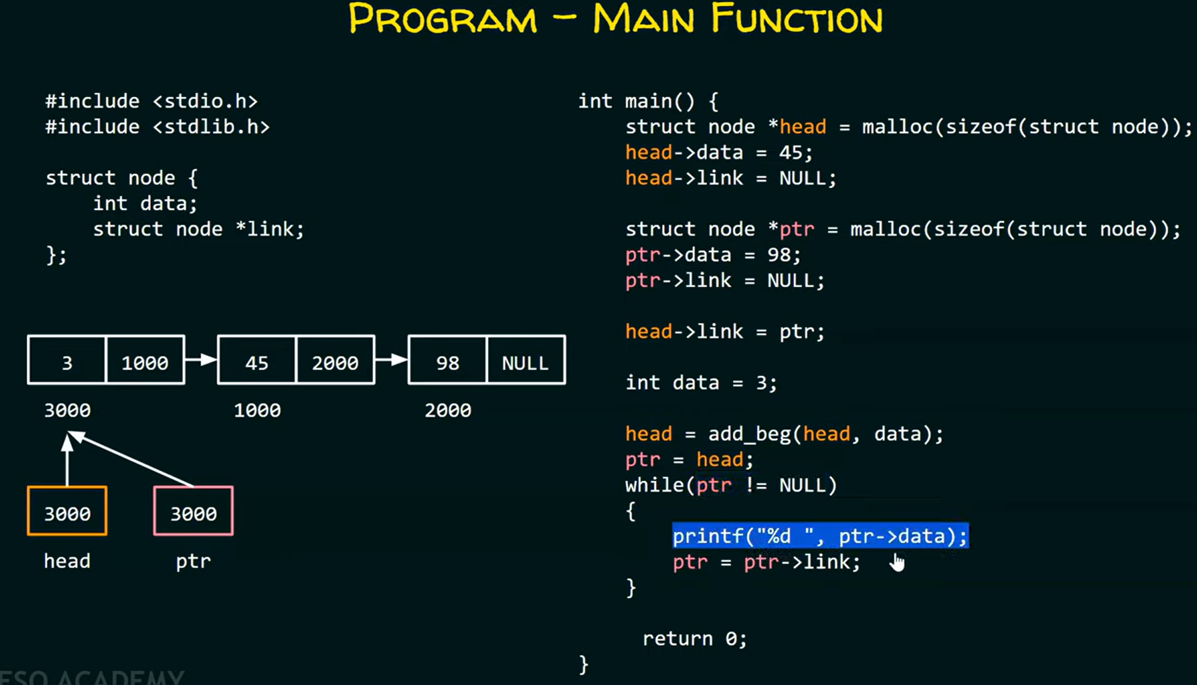

Slide 20
Deleting a Starting node

Slide 21
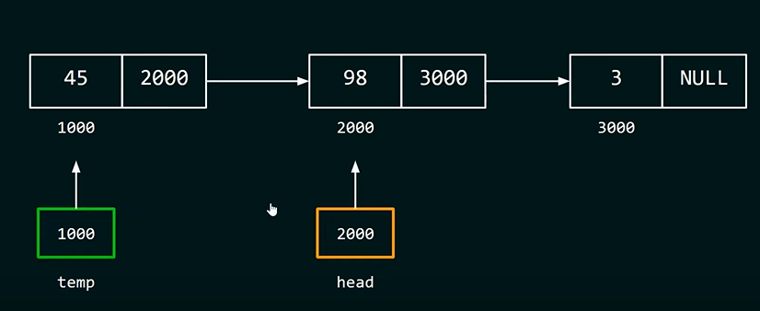

Slide 22
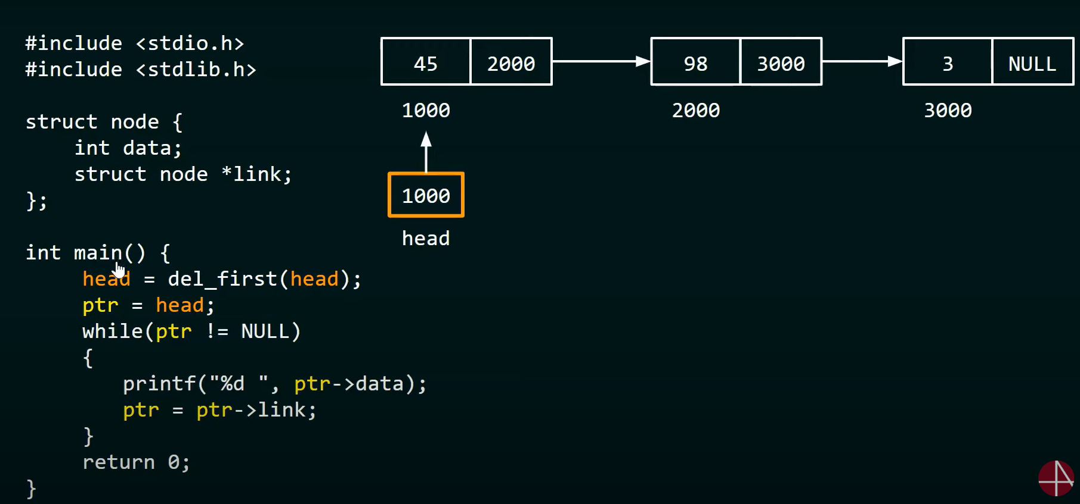

Slide 23
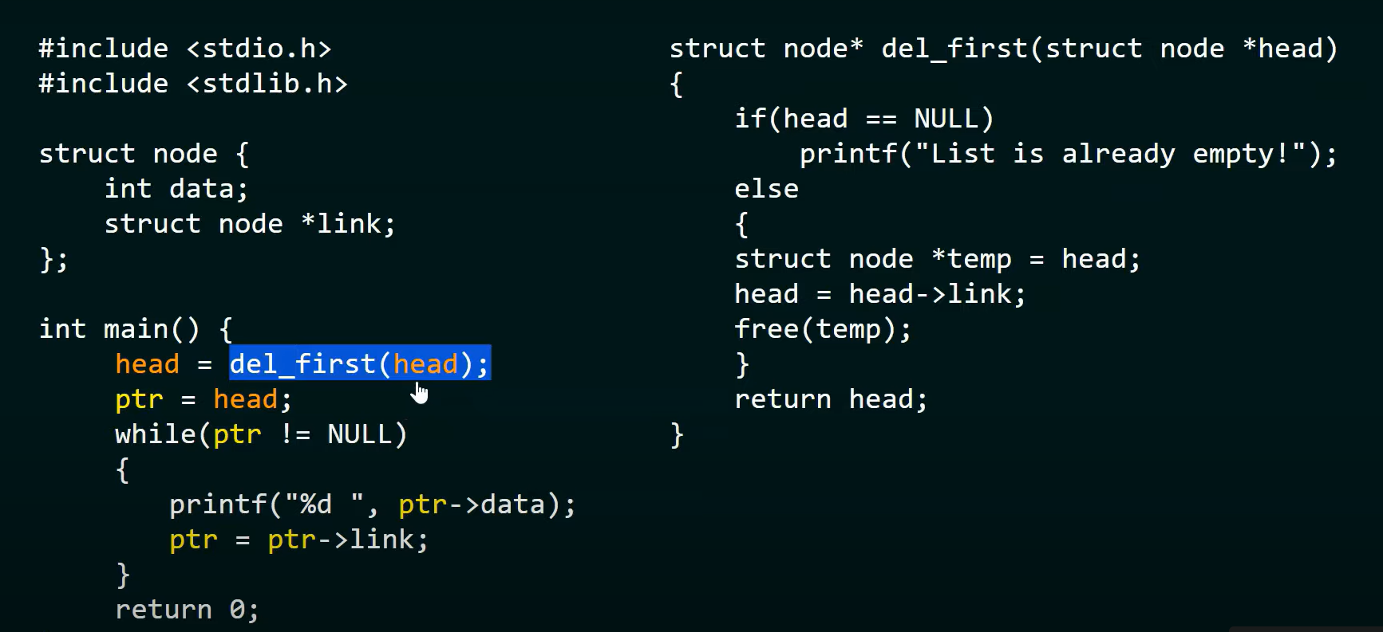

Slide 24
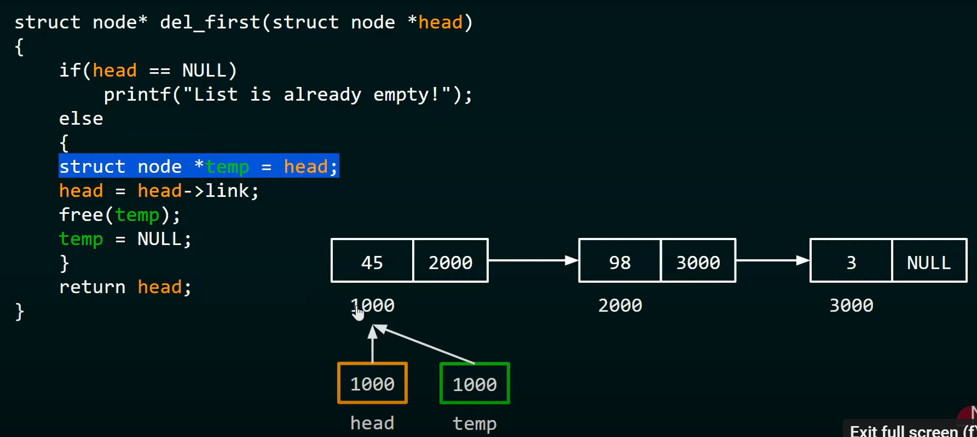

Slide 25
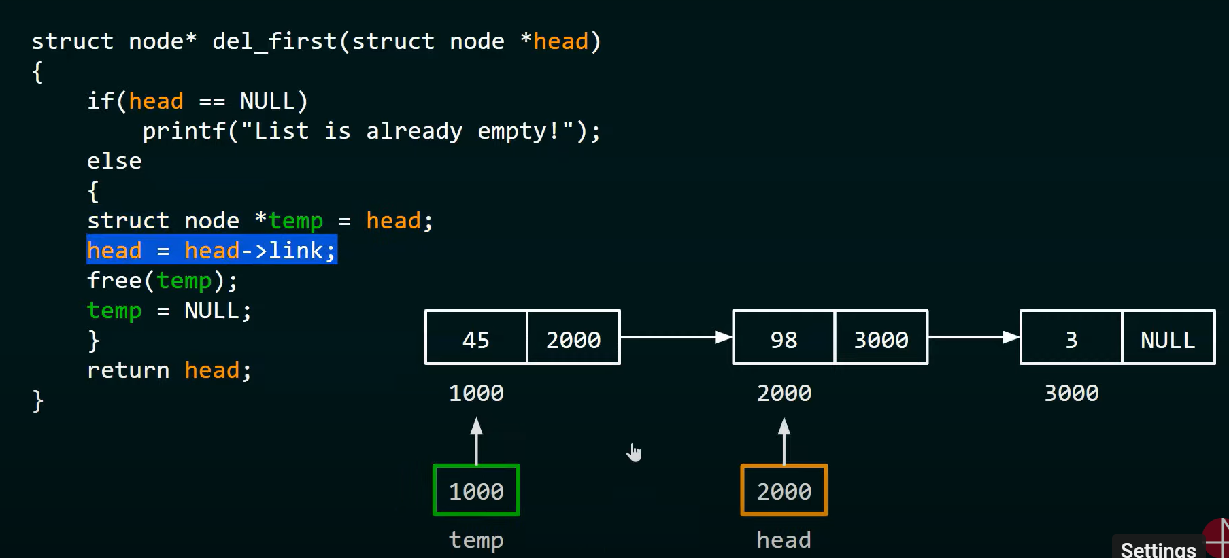

Slide 26
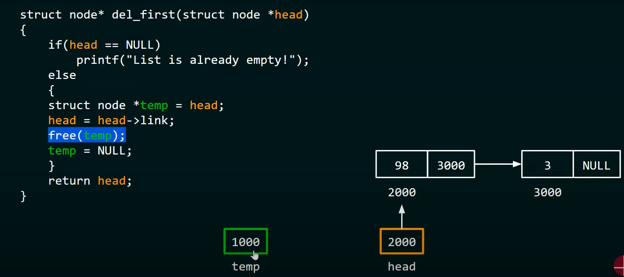

Slide 27
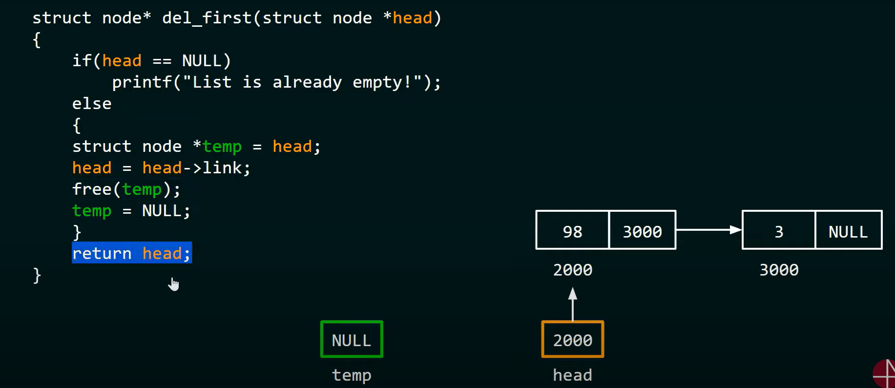

Slide 28
